Slide 1

Co-Responder Services
ARPA Grant Application
FAQ Session
ACHD BEHAVIORAL HEALTH TEAM/ARPA RECOVERY TEAM

Slide 2

FAQ Session Overview
1
Overview of Federal Grant Requirements and Reporting
2
Co-Responder Services Application
How to apply on eCivis
Review County goals and funding priority categories
Examples of services for each funding priority category
Review of FAQs and questions
3
4
2
CO-RESPONDER SERVICES ARPA APPLICATION FAQS

Slide 3
Section 1:
Federal Grant Requirements
8
3
CO-RESPONDER SERVICES ARPA APPLICATION FAQS
Notes:
State and Local Fiscal Recovery Funds American Rescue Plan Act Dollars

Slide 4
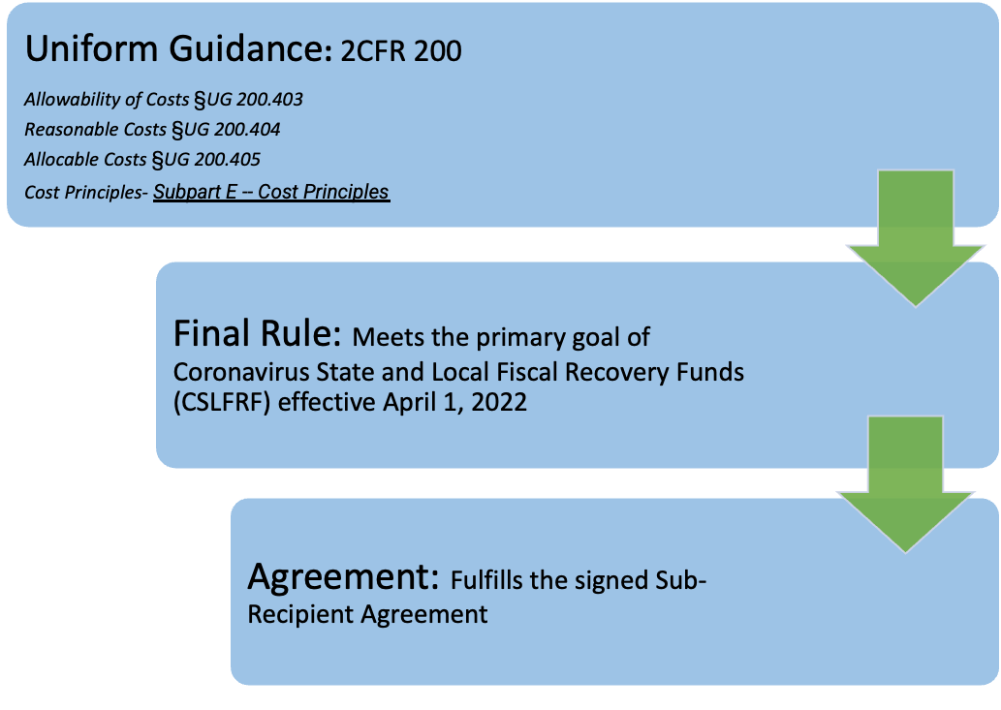
Factors Determining Expenses: Order of Precedence
4
CO-RESPONDER SERVICES ARPA APPLICATION FAQS

Slide 5
Allowable Expenses per UG § 200.403
To be allowable, a cost must:
Be necessary and reasonable for the performance of federal awards
Conform to any limitations or exclusions set forth in the Federal award as to cost items
Be consistent with policies and procedures for non-federal expense
Be accorded consistent treatment in like circumstances
Follow generally accepted accounting principles (GAAP)
Not be used to meet cost sharing or matching of another federal award
Be adequately documented and incurred within approved budget period
Costs not specifically prohibited by federal regulation or the specific grant/contract
5
CO-RESPONDER SERVICES ARPA APPLICATION FAQS

Slide 6
Reasonable Expenses per UG § 200.404
To be reasonable, a cost must be:
Ordinary and necessary for operation or efficient performance of a federal award
Follow sound business and best practices, federal terms and regulations
Follow market price for comparable goods and services for geographic area
Administered with prudence with regards to responsibilities
Doesn't significantly deviate from practices and polices regarding incurrence of costs
Costs that reflect what a prudent person would pay
6
CO-RESPONDER SERVICES ARPA APPLICATION FAQS

Slide 7
Unallowable Expenses
Per Uniform Guidance
    Alcoholic Beverages
    Contributions and Donations
    Fines & Penalties
    Interest
    Lobbying
    Pre-Award Costs
Per SLFRF April 2022 Compliance Supplement
    Debt service or replenishing financial reserves (ex: rainy day funds)
    Satisfaction of settlements
    Any program, services or capital expenses that undermines the efforts to stop the spread of COVID-19
7
CO-RESPONDER SERVICES ARPA APPLICATION FAQS

Slide 8
Overview of Expenditure Categories (EC)
Per the US Treasury's Compliance & Reporting Guidance, all expenditures must be reported under one of the following Expenditure Categories (EC):
EC1. Supports Public Health Expenditures
EC2. Addresses Negative Economic Impacts to Households/Small Businesses/Non-Profits/ Industries
EC3. Addresses Public Health-Negative Economic Impact: Public Sector Capacity
8
CO-RESPONDER SERVICES ARPA APPLICATION FAQS
Notes:
Expenditure categories can be found on starting on page 9:
https://home.treasury.gov/system/files/136/SLFRF-Compliance-and-Reporting-Guidance.pdf

Slide 9
Common Federal Expense Categories
1. Public Health
Community Violence Interventions
1.11 Community Violence Interventions
Behavioral Health
1.12 Mental Health Services
1.13 Substance Use Services
Other
1.14 Other Public Health Services
Assistance to Households (continued)
2.11 Healthy Childhood Environments: Child Care
2.12 Healthy Childhood Environments: Home Visiting
2.13 Healthy Childhood Environments: Services to Foster Youth or Families Involved in Child Welfare System
2.14 Healthy Childhood Environments: Early Learning
2.15 Long-term Housing Security: Affordable Housing
2.16 Long-term Housing Security: Services for Unhoused Persons
2.17 Housing Support: Housing Vouchers and Relocation Assistance for Disproportionately Impacted Communities*^
2.18 Housing Support: Other Housing Assistance
2.19 Social Determinants of Health: Community Health Workers or Benefits Navigators
2.20 Social Determinants of Health: Lead Remediation
2.21 Medical Facilities for Disproportionately Impacted Communities
2.22 Strong Healthy Communities: Neighborhood Features that Promote Health and Safety
2.23 Strong Healthy Communities: Demolition and Rehabilitation of Properties
2.24 Addressing Educational Disparities: Aid to High-Poverty Districts
2.25 Addressing Educational Disparities: Academic, Social, and Emotional Services
2.27Addressing Impacts of Lost Instructional Time
2.28 Contributions to UI Trust Funds
2. Negative Economic Impacts
Assistance to Households
2.1 Household Assistance Food Programs
2.2 Household Assistance, Rent, Mortgage, and Utility Aid
2.3 Household Assistance : Cash Transfers
2.4 Household Assistance : Internet Access Programs
2.5 Household Assistance :Paid Sick and Medical Leave
2.6 Household Assistance : Health Insurance
2.7 Household Assistance : Services for Un/Unbanked
2.8 Household Assistance : Survivor’s Benefits
2.9 Household Assistance : Unemployment Benefits or Cash Assistance to Unemployed Workers
2.10 Assistance to Unemployed or Underemployed Workers (job training, subsidized employment, employment supports or incentives)
9
CO-RESPONDER SERVICES ARPA APPLICATION FAQS

Slide 10

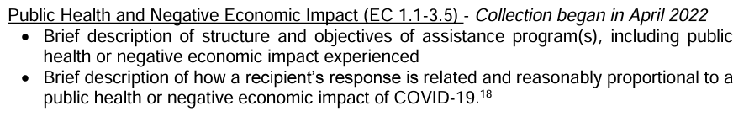
“These are necessary to allow Treasury to conduct oversight as well as understand and aggregate program outcomes across recipients.”
Evidence-Based Interventions – Subrecipients must identify the amount of the total funds allocated to evidence-based interventions
Mandatory performance indicators and programmatic data, where relevant
10
CO-RESPONDER SERVICES ARPA APPLICATION FAQS

Slide 11
Expenditure Guidelines per the SLFRF: Final Rule
Key Principles
Respond to pandemic needs and support families and businesses struggling with health and economic impacts respectively
Maintain vital public services, amidst declines in revenue, and
Build a strong, resilient, and equitable recovery by making investments that support long-term growth and opportunity
Caveat
  Refer to your agreement for use of funds, performance dates, and milestones.
  Programs designed to reduce the impact should be related and reasonably proportional to the harm identified and reasonably designed to benefit those impacted for eligible use only
  Equity Considerations: SRLRF funds are tied to serving underserved & disproportionately impacted communities & businesses affected by pandemic (Executive Order 13985)
11
CO-RESPONDER SERVICES ARPA APPLICATION FAQS

Slide 12
Grant Reporting Requirements
Financial - Monthly
Subrecipients will submit an expenditure report with supporting documentation no later than the 15th of each month via the grant reporting platform.
Supporting Documentation = Proof of Payment/Purchase
Invoices
Paystubs
Billing Statements with dates of services
Itemized receipts
Bank Statements
Copies of checks
Credit Card Statements
12
CO-RESPONDER SERVICES ARPA APPLICATION FAQS

Slide 13
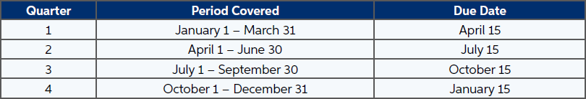
Grant Reporting Requirements
Programmatic - Quarterly
Subrecipients will submit a progress report each quarter. The report includes milestones, accomplishments, and significant events or activities that occurred during the reporting quarter.
13
CO-RESPONDER SERVICES ARPA APPLICATION FAQS
Notes:
Progress made towards the goals developed with RMP
*Disclaimer – based on funding amount, additional reporting may be required

Slide 14
Additional Reporting Requirements
Required for all Expenditure Categories
Project description
Description of program structure and objectives, including public health and/or behavioral health impact experienced
Description of relation to COVID-19
Populations of Focus – Subrecipients must report on whether project(s) currently serves, or intends to serve, populations of focus as outlined in the Behavioral Health Services and Supports Assessment: A Blueprint for Action
Capital Expenditures
Program income earned and expended to cover eligible project costs
14
CO-RESPONDER SERVICES ARPA APPLICATION FAQS
Notes:
As a recipient of an award under the SLFRF program, your organization is responsible for complying with requirements for the use of funds.

Slide 15
Section 2:
Co-Responder Services Application
8
15
CO-RESPONDER SERVICES ARPA APPLICATION FAQS

Slide 16

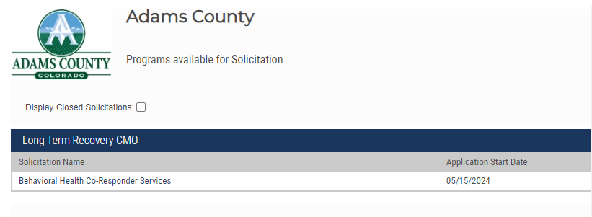
ACCESSING THE APPLICATION
https://gn.ecivis.com/GO/gn_redir/T/19t06ozkq7vk0
Create an Account
Portal Login
Verify Email
Select Apply
Select Solicitation

Slide 17
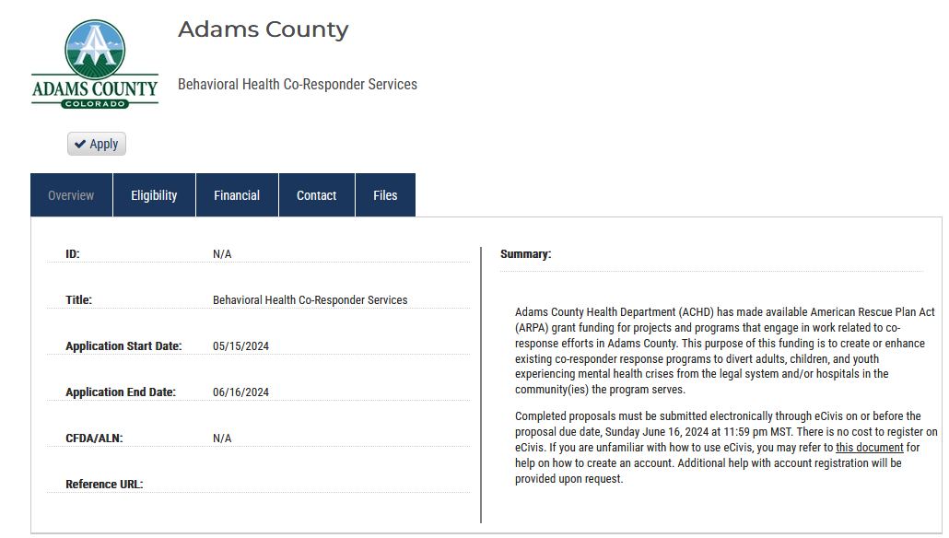
ACCESSING THE APPLICATION
https://gn.ecivis.com/GO/gn_redir/T/222rpw5pyzjw
Create an Account
Portal Login
Verify Email
Select Apply
Select Solicitation

Slide 18
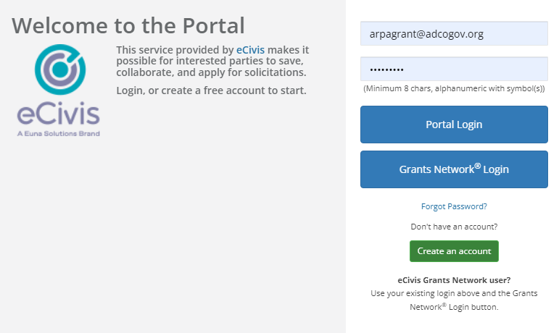
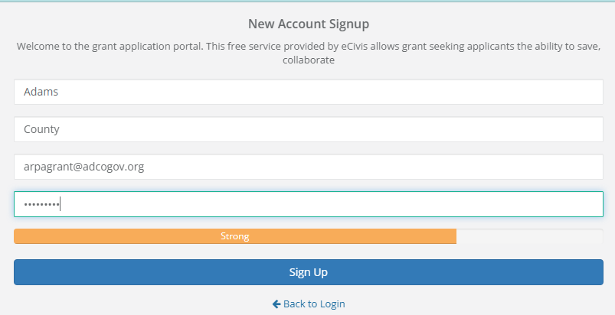
ACCESSING THE APPLICATION
https://gn.ecivis.com/GO/gn_redir/T/222rpw5pyzjw
Create an Account
Portal Login
Verify Email
Select Apply
Select Solicitation

Slide 19

ACCESSING THE APPLICATION
https://gn.ecivis.com/GO/gn_redir/T/222rpw5pyzjw
Create an Account
Portal Login
Verify Email
Select Apply
Select Solicitation

Slide 20
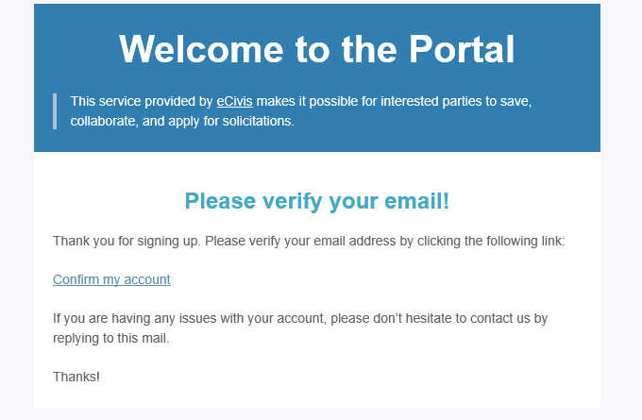
ACCESSING THE APPLICATION
https://gn.ecivis.com/GO/gn_redir/T/222rpw5pyzjw
Create an Account
Portal Login
Verify Email
Select Apply
Select Solicitation

Slide 21
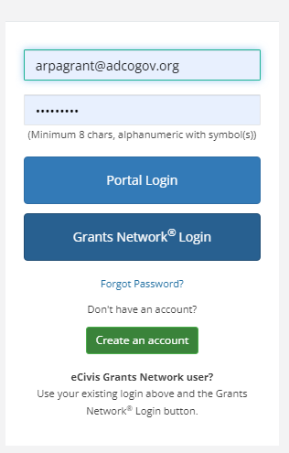

ACCESSING THE APPLICATION
https://gn.ecivis.com/GO/gn_redir/T/222rpw5pyzjw
Create an Account
Portal Login
Verify Email
Select Apply
Select Solicitation

Slide 22

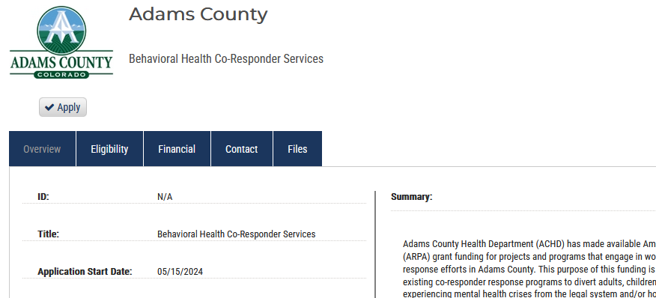
ACCESSING THE APPLICATION
https://gn.ecivis.com/GO/gn_redir/T/222rpw5pyzjw
Create an Account
Portal Login
Verify Email
Select Apply
Select Solicitation

Slide 23
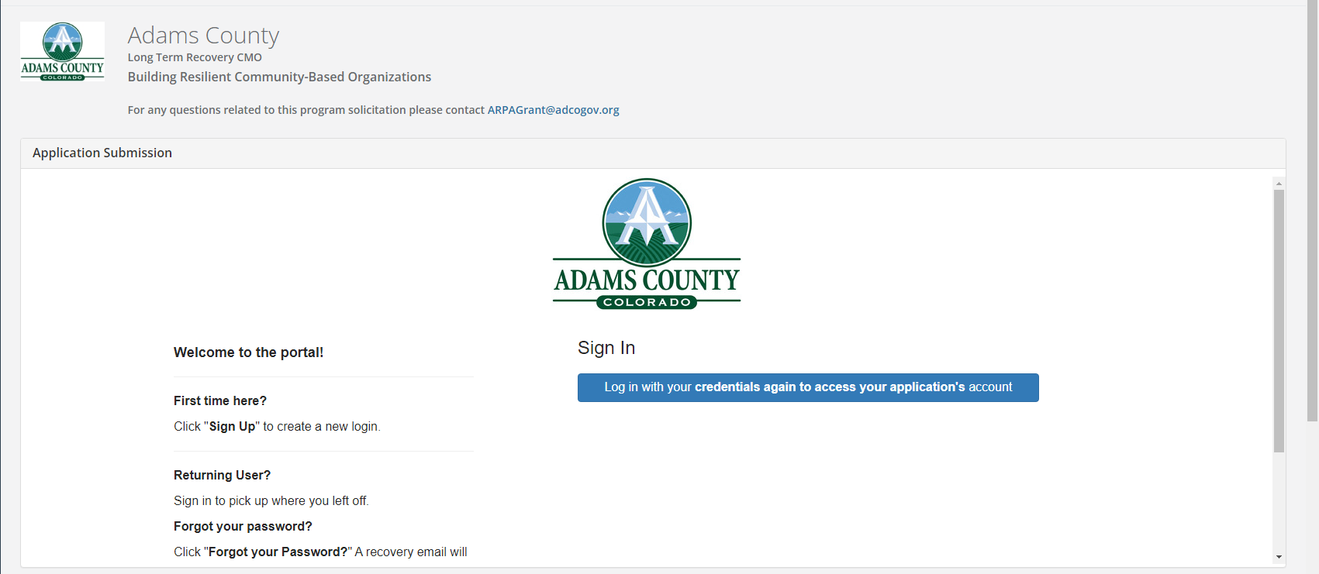
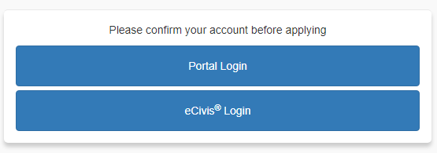
ACCESSING THE APPLICATION

Slide 24
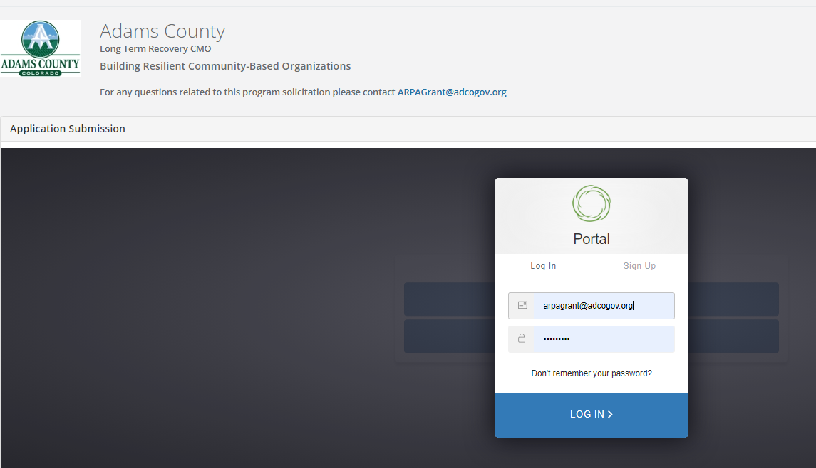
COMPLETING YOUR PROFILE

Slide 25
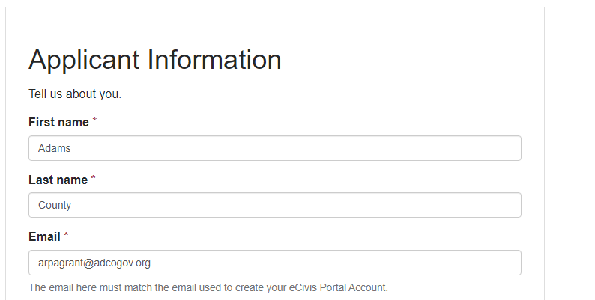
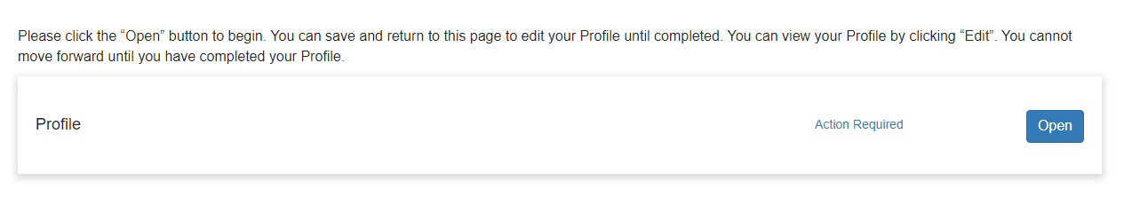

COMPLETING YOUR PROFILE
The email is used to create your Portal Account, MUST be used as your email in the profile.
BRCBO ARPA PPLICATION FAQS

Slide 26

EDITING YOUR PROFILE
Edit:
Applicant Information
Organization Information
Notes:
change of address, update phone number, new UEI,

Slide 27
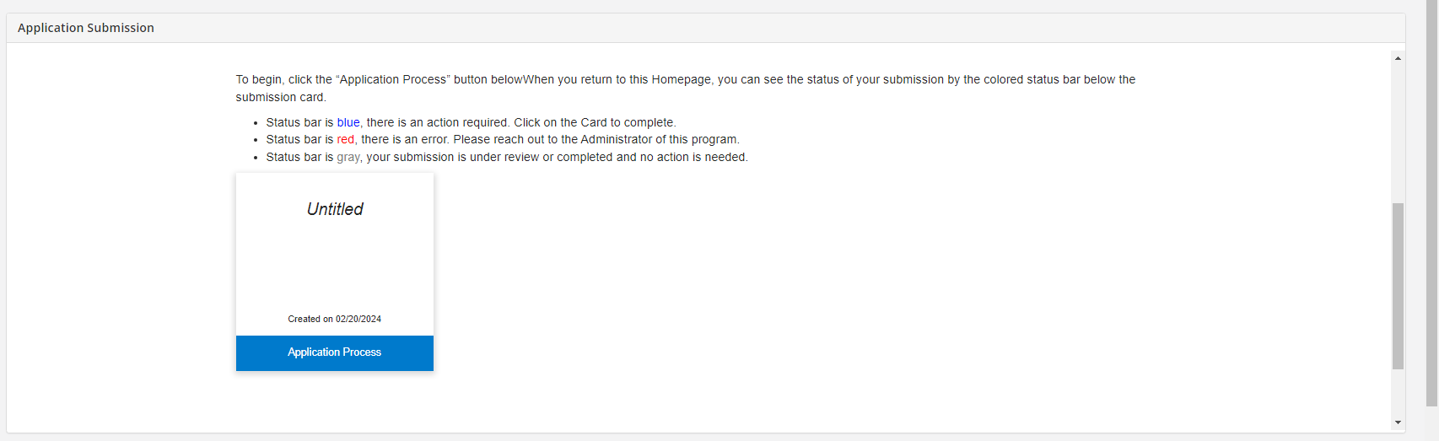
COMPLETING THE APPLICATION

Slide 28
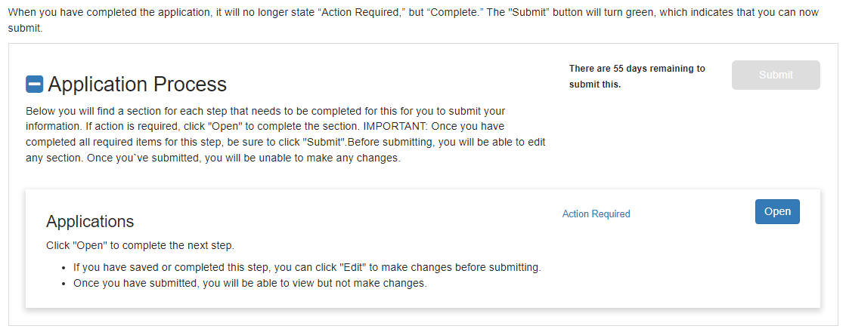

COMPLETING THE APPLICATION

Slide 29
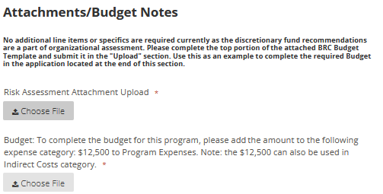
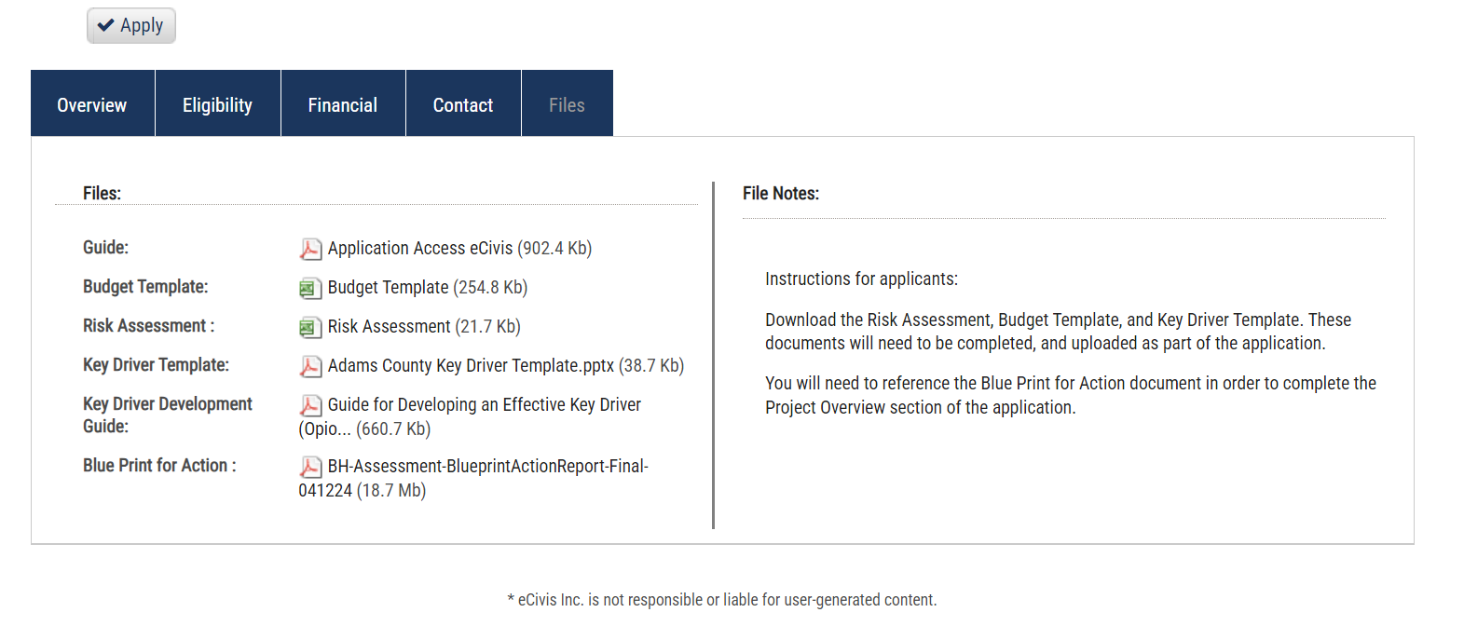
ATTACHMENTS
Notes:
Only complete the Risk Assessment.
The budget does not need to be completed in the system. Upload the blank template with your organization information filled out.

Slide 30
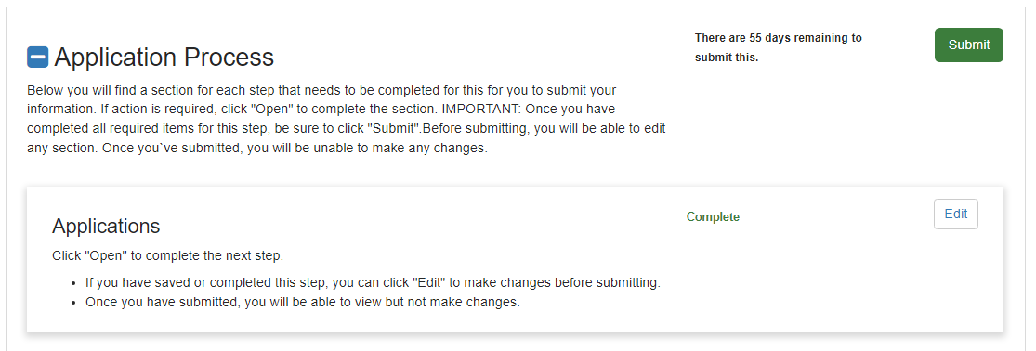
APPLICATION SUBMISSION

Slide 31
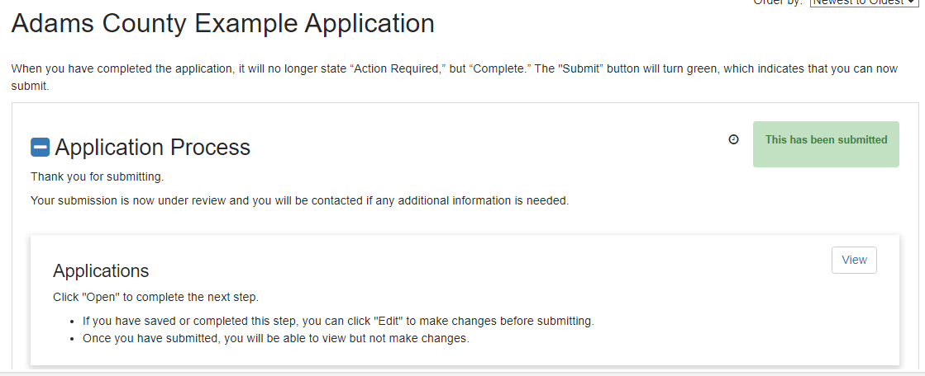
APPLICATION SUBMISSION

Slide 32
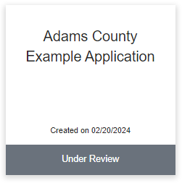
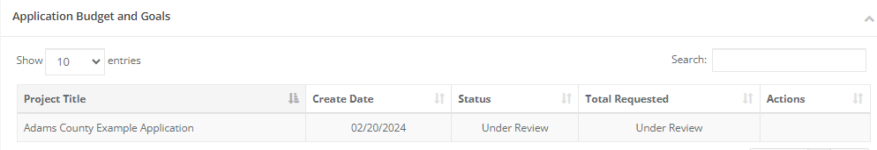
APPLICATION SUMISSION

Slide 33




Funding Priority Categories:
Community Services
Program Supports
Direct
Services
Staff
Supports
Program
Costs
Building
Capacity
Direct Costs for Services
Temporary Services and Treatments (necessary to stabilize a participant’s condition)
Case Management
Program Personnel
Community Engagement and Outreach Efforts
Paid Internships
Pre-Licensure Stipends
Overtime costs
Data Collection Tools
Start Up Costs
Program Supports
Specialized Trainings or Certifications
Technical Assistance
Language Training
33
CO-RESPONDER SERVICES ARPA APPLICATION FAQS

Slide 34
Key Recommendations and Intended Impact:
RECOMMENDATIONS​
A: Leverage workforce development strategies for local providers (i.e., community health workers, peer support professionals, and qualified behavioral health assistants).
B: Improve access to linguistically congruent care (i.e., increase capacity and diversity of bilingual and multilingual workforce, offer translation services, etc.)
C: Improve access to culturally congruent and tailored care (i.e., certifications, organizational trainings, community-based and community-initiated care trainings).
D: Improve access to behavioral healthcare in accessible and preferred settings (i.e., co-located services, mobile services, and flexibility in service hours).
E: Improve and increase care coordination and case management among providers, systems, and across jurisdictions.
Intended Impact: "To create or enhance existing co-responder response teams to support adults, children, and youth experiencing mental health crises in high need community(ies)." Specific impact(s) can be tailored to project based on proposal.
34
CO-RESPONDER SERVICES ARPA APPLICATION FAQS

Slide 35
Funding Priority Categories:
Direct
Services
Direct Services
Direct Costs for Services
  Potential to impact Recommendations C, D
Temporary Services and Treatments (necessary to stabilize a participant’s condition)
  For example, cost of services that may enable an individual to avoid hospitalization or incarceration
  Potential to impact Recommendation D
35
CO-RESPONDER SERVICES ARPA APPLICATION FAQS
Notes:
When we discuss these slides, it is important we make it clear that these are "examples of potential response to the recommendations listed"
- we are prompting them, but we are not suggesting that each expense impacts each recommendation listed.
- For example, just because direct costs for services is an expense of their proposal, this does not mean the proposal aligns with both recommendations listed. Recommendation C (for example) would require that the direct services expense is to improve or increase culturally congruent care/services.

Slide 36
Funding Priority Categories:
Staff
Supports
Program Supports: Staff Supports
Program Personnel and Related Staff Supports
  Including, but not limited to, hiring co-responders, case managers, and navigators, as well as staff supports including case management, overtime costs for additional hours worked (e.g., attending community of practice meetings or trainings, expanding coverage hours, etc.).
  Potential to impact Recommendations A, B, C, D, E
Community Engagement and Outreach Efforts
  Costs supporting community engagement, education, and outreach in support of the County’s goals of expanding program utilization // Potential to impact Recommendations B, C, D, E
Paid Internships, Pre-Licensure Stipends, and Staff Incentives
  These supports increase capacity and reach of co-response efforts, a key goal of this funding // Potential to impact Recommendation A
36
CO-RESPONDER SERVICES ARPA APPLICATION FAQS

Slide 37
Funding Priority Categories:
Program
Costs
Program Supports: Program Costs
Data Collection
  Can support the cost of data collection tools and/or staff time to support data collection and aggregation efforts.
  This aligns with County goals of evaluating programmatic impact and creating a case for sustainability // Potential to impact Recommendations A, B, C, D, E
Start Up Costs (for new programs)
  Potential to impact Recommendations A, B, C, D, E
Program Supports (e.g., unmarked transport vehicles)
  Purchase of items intended to increase the capability of programs to provide trauma informed, culturally congruent, and/or linguistically congruent services
  Potential to impact Recommendations C, D
37
CO-RESPONDER SERVICES ARPA APPLICATION FAQS

Slide 38
Funding Priority Categories:
Building
Capacity
Program Supports: Building Capacity
Specialized Trainings or Certifications
  Potential to impact Recommendations A, B, C
Technical Assistance
  Potential to impact Recommendations B, C, D, E
Language Training
  Purchase of tools, trainings, courses, and/or technical assistance (including interpretation and translation services) aimed at increasing the linguistic congruence of services provided.
  Potential to impact Recommendations A, B, C
38
CO-RESPONDER SERVICES ARPA APPLICATION FAQS

Slide 39
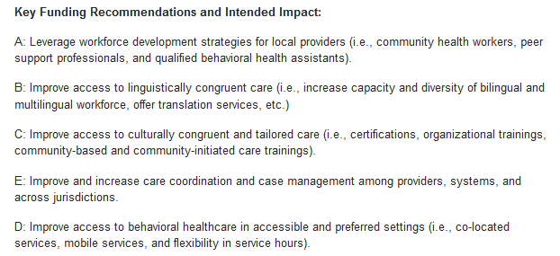
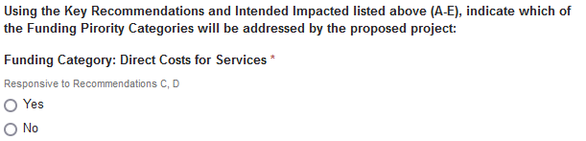
Funding Priority Categories:
Selecting in the Application
39
CO-RESPONDER SERVICES ARPA APPLICATION FAQS

Slide 40
SCORING CRITERIA
Problem Statement (10 Points Total)
Demonstrates understanding of the nature and scope of the issue to be addressed (using data and research as support) Provides compelling description of the need for assistance and justifies the need for resources requested to address the problem
Project Overview and Impact (20 Points Total)
Selects at least one key recommendation and describes how proposal will address key recommendation Additional points will be given for proposals that address more than one recommendation Includes description of how the program will create new or enhance existing co-response services and supports Explains gaps in services addressed by project and how project will avoid duplication of services
Capacity and Sustainability (15 Points Total)
Explains why organization is the one to respond to this issue/challenge Demonstrates consideration of longer-term funding and sustainability strategy(ies) Describes the organization’s capacity to participate in Adams County Co-Responders Community of Practice and support data collection from a third-party evaluator If applicable, includes a letter of support from partner agencies demonstrating agency commitment to the project (no scoring, but must be verified)

Slide 41
SCORING CRITERIA, cont.
Equity Considerations (20 Points Total)
Describes how project currently serves or intends to serve populations of focus (i.e., youth and young adults; older adults; Black, Indigenous, and People of Color (BIPOC); lesbian, gay, bisexual, transgender, queer/questioning, intersex, asexual, and individuals with other sexual and gender identities (LGBTQIA+); people without documentation; people who are unhoused; individuals with low incomes; people who are pregnant and/or postpartum; individuals with disabilities; and individuals who have interfaced with the carceral system) Describes how the proposed project aims to address needs outlined in Finding 2 (the need for culturally congruent, linguistically congruent, and tailored behavioral health services and supports)
Project Implementation (15 Points Total)
Offers a thorough explanation of target outcomes and key performance indicators for the project with timelines associated
Budget (20 Points Total)
Budget Spreadsheet: The budget is complete, aligns with proposed activities and deliverables, and includes allowable expenses (e.g., reasonable, allocable, and necessary for project activities) given the amount of federal funding requested Budget Narrative: The budget narrative clearly explains and justifies the estimated costs in the budget. The proposed budget costs are reasonable, realistic, and justified. The narrative clearly explains the organization’s capacity and plan to utilize the requested budget amount over the duration of the grant term
Total

Slide 42
FAQs:
Submission & Notification Timeline
Co-Responder NOFO​ Submission Guidelines
LIVE LAUNCH!​ | May 15th – June 16th ​
Virtual Information Session​ | May 22, 2024
Proposal Scoring​ | by June 26, 2024
Award Decision Notifications | Week of July 22, 2024​
BOCC Approval and Award Ceremony​ | August 6, 2024
Kick-off Meeting w/Grantees​ | August 22, 2024
Deadline to Expend Funds | December 31, 2026 ​
42
CO-RESPONDER SERVICES ARPA APPLICATION FAQS
Notes:
Once a final decision is made the organization will be informed immediately and be given 7 to 10 days to decide on acceptance. Funds will be disbursed based on Contract execution.

Slide 43
FAQs: Federal Grants
This is a Federal grant, all grantees must follow 2 C.F.R Part 200 establishes uniform administrative requirements, cost principles, and audit requirements for Federal awards to non-Federal entities.
To enter into an agreement with the County, your organization must have an active registration on SAM.gov.
Will this federal grant recognize federally negotiated indirect costs (facilities and administrative costs) and fringe benefit expense rates?
Yes, 10% or federally negotiated rate.
Payments: We do not offer reimbursements. Payments will be made as 1 or 3 payments.
Can funding be used for FTEs?
Yes, this should be indicated in your budget.
Can you apply if your organization/services are outside of Adams County?
Yes, however, all expenses for this grant must serve Adams County residents.
  Example: FTE 30% of time is spent working with Adams County residents, then 30% of FTE could be covered by the grant.
43
CO-RESPONDER SERVICES ARPA APPLICATION FAQS

Slide 44
FAQs:
What Grant Management System will be used?
eCivis will be our monitoring platform. Onboarding sessions will be held to learn about the system.
How long is the grant period and will there be a reapplication after the initial use of these funds?
Funds must be used by Dec. 31, 2026 (the federal deadline for all ARPA funds). Currently, there will not be a reapplication after this initial use of funds. Shorter term funding may be requested (this should be indicated in your workplan and where requested in your application).
What is an external program evaluation?
An external program evaluation provider will help to assess the causal effect of the program on outcomes and support co-responder programs to quantify met and unmet needs. The evaluation provider will support co-responder programs to standardize data collection, data utilization, and identify metrics that demonstrate program impact. The County will pay for this service and doesn’t need to be added to your budget. Data gathered may be used to support program sustainability efforts.
Would providing facility upgrades or purchasing program supplies (such as unmarked vehicles for transport) be allowable given funding restrictions?
Yes.
44
CO-RESPONDER SERVICES ARPA APPLICATION FAQS

Slide 45
FAQs:
What does a commitment to participating in the Adams County Co-Responders Community of Practice (CoP) mean/look like?
Commitment entails attending and participating in at least four of the six Community of Practice meetings per calendar year (to take place on the first Thursday of every other month from 9:00 – 10:30 AM). A virtual option is available for those unable to participate in person. If there is a need to revisit this day and time, Adams County Health Department will address this with awarded grantees.
Does our project have to be fully sustainable by the end of the grant term to be considered for funding.
Funding will not be based on your organization’s answer to this application question. This said, we would like to learn more about your organization's plans for longer term funding and sustainability.
Can you explain how proposals will be weighted based on the recommendation(s) they address?
Organizations that select one recommendation and clearly explain how their proposal addresses selected recommendation will receive full (10) points. An extra five points will be given for each additional recommendation addressed by the proposal.
Is assistance available to support creation of key drives/key performance indicators?
Yes, Rocky Mountain Partnership will be available to provide technical assistance with key drivers and associated templates.
45
CO-RESPONDER SERVICES ARPA APPLICATION FAQS

Slide 46

QUESTIONS?
.
CO-RESPONDER SERVICES ARPA APPLICATION FAQS
5
Notes:
General Requirements for all applicants:
Must use county-mandated software for grant management and client tracking.
Participate in external program evaluation.
Must have active registration on SAM.gov.
Must be in good standing with the state.
Practitioners must be licensed in the State of Colorado and be in good standing. Lawyers must be in good standing with the Colorado Bar Association.
Must be in good standing with other Adams County grant awards (if applicable).
In addition, the Rapid Response Agency applicants must:
The Rapid Response Agency must be available 24/7 to provide emergency services and or coordination of care (such as medical services, legal assistance, therapeutic services, financial services, food, emergency shelter/housing, transportation, etc.).
Proven experience working with survivors of Domestic Violence.
Must have demonstrated partnerships and collaborations with crime victim services agencies.
Willing to collaborate on centralizing the 24/7 coordination of services (e.g., hotline).

